Slide 1

Academic Research Thesis Defense
Here is where your presentation begins

Slide 2

Table of Contents
01
02
03
04
Section A
Section B
Here you can describe the topic of the section
Here you can describe the topic of the section
Section C
Section D
Here you can describe the topic of the section
Here you can describe the topic of the section

Slide 3
“Venus has a beautiful name and is the second planet from the Sun. It’s terribly hot—even hotter than Mercury”
—Someone Famous

Slide 4
Study Objectives
Mercury
Mars
Mercury is the closest planet to the Sun and the smallest
Despite being red, Mars is actually a really cold place

Slide 5
Literature Review
Mercury
Mars
Venus
Mercury is the closest planet to the Sun
Despite being red, Mars is actually cold
Venus has a beautiful name, but it’s hot
Neptune
Earth
Jupiter
It’s the farthest planet from the Sun
Earth is the beautiful planet we live on
Jupiter is the biggest planet of them all

Slide 6
Big Numbers May Be Useful
25M
50%
30K
Mercury
Mars
Mercury is the closest planet to the Sun
Despite being red, Mars is actually cold
Venus
Venus has a beautiful name, but it’s hot

Slide 7
This is a timeline
Mars
Neptune
Despite being red, Mars is actually cold
Neptune is very far away from Earth
Mercury
Venus
Mercury is the closest planet to the Sun
Venus has a beautiful name, but it’s hot

Slide 8
Schedule
Mercury is the closest planet to the Sun
May 2021
Despite being red, Mars is actually cold
June 2021
Venus has a beautiful name, but it’s hot
July 2021
Neptune is the farthest planet from the Sun
August 2021

Slide 9
Methodology
Mercury
Mars
Mercury is the closest planet to the Sun
Despite being red, Mars is actually cold
Venus
Neptune
Venus has a beautiful name, but it’s hot
Neptune is very far away from Earth

Slide 10
Calendar
Mercury is the smallest planet
Mars is a really cold place
Week 1 | 1 | 2 | 3 | 4 | 5 | 6 | 7
Week 2 | 8 | 9 | 10 | 11 | 12 | 13 | 14
Week 3 | 15 | 16 | 17 | 18 | 19 | 20 | 21
Week 4 | 22 | 23 | 24 | 25 | 26 | 27 | 28
Week 5 | 29 | 30 | 31 | 1 | 2 | 3 | 4

Slide 11
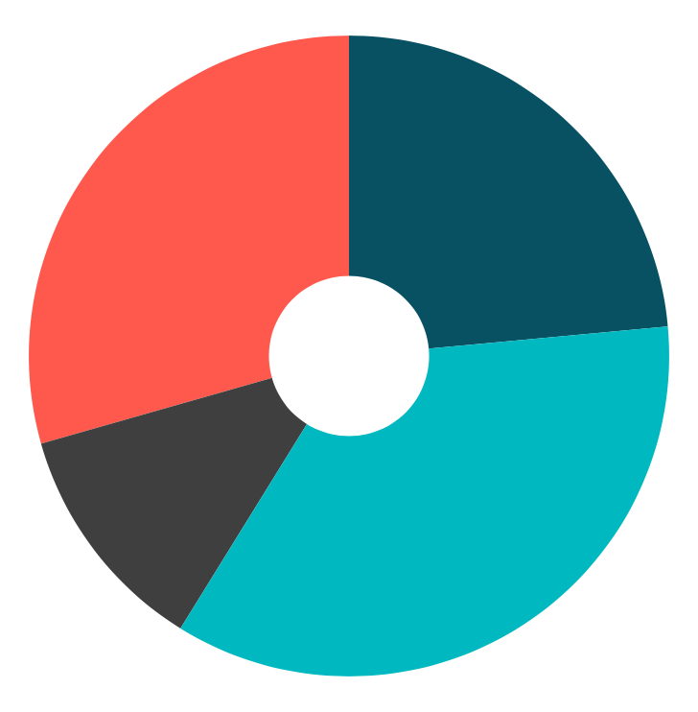
Results Analysis
30%
25%
Mars
Neptune
Despite being red, Mars is actually cold
Neptune is very far away from Earth
10%
35%
Mercury
Venus
Mercury is the closest planet to the Sun
Venus has a beautiful name, but it’s hot
To modify this graph, click on it, follow the link, change the data and paste the new graph here

Slide 12
This Is a Map
Mars
Despite being red, it is actually cold
Venus
It’s the second planet from the Sun
Mercury
It is the closest planet to the Sun

Slide 13
150K
Big numbers may help you catch your audience’s attention

Slide 14

This Is a Mockup
You can replace the image on the screen with your own work. Right-click on it and then choose “Replace image” so you can add yours

Slide 15
Bibliographical References
Author (Year). Title of publication. Publisher
Author (Year). Title of publication. Publisher
Author (Year). Title of publication. Publisher
Author (Year). Title of publication. Publisher
Author (Year). Title of publication. Publisher
Author (Year). Title of publication. Publisher
Author (Year). Title of publication. Publisher
Author (Year). Title of publication. Publisher

Slide 16





Storyset
Create your Story with our illustrated concepts. Choose the style you like the most, edit its colors, pick the background and layers you want to show and bring them to life with the animator panel! It will boost your presentation. Check out How it Works.
Pana
Amico
Bro
Rafiki
Cuate

